Slide 1
Icing On the Cake
www.icingonthecakeprogram.blogspot.com

Slide 2
Icing On the Cake
DXN LIFE-TIME INCOME
Do you have 200.00€ cash?
What business can you
do with 200.00€?
• How much can you earn
with 200.00€ as capital?
• You can start doing DXN
business by purchasing
your unit of Icing On
The Cake
www.marktacorda.mydxn.net | www.dxn2u.com

Slide 3
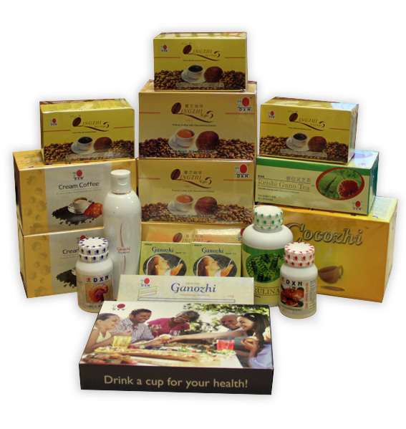
Icing On the Cake
DXN LIFE-TIME INCOME
Business Opportunity
By paying 200.00€
1.You will automatically
become a member of DXN
2.You can buy DXN products at
DP price totaling 200.00€
3.You will be provided with
the basic training to do DXN
Business
www.marktacorda.mydxn.net | www.dxn2u.com

Slide 4
Icing On the Cake
DXN LIFE-TIME INCOME
STRUCTURE FOR €200.00 PACKAGE
10 X 10 Structure - Icing On the Cake (€200,00 = Products)
GEN | IOC MEMBERS | SV | TOTAL iSV | % | BONUS | TOTAL BONUS
1 | 10,00 | 100 | 1.000,00 | 15% | € 150,00 | € 150,00
2 | 100,00 | 100 | 10.000,00 | 10% | € 1.000,00 | € 1.150,00
3 | 1.000,00 | 100 | 100.000,00 | 5% | € 5.000,00 | € 6.150,00
4 | 10.000,00 | 100 | 1.000.000,00 | 5% | € 50.000,00 | € 56.150,00
5 | 100.000,00 | 100 | 10.000.000,00 | 5% | € 500.000,00 | € 556.150,00
6 | 1.000.000,00 | 100 | 100.000.000,00 | 5% | € 5.000.000,00 | € 5.556.150,00
7 | 10.000.000,00 | 100 | 1.000.000.000,00 | 5% | € 50.000.000,00 | € 55.556.150,00
8 | 100.000.000,00 | 100 | 10.000.000.000,00 | 5% | € 500.000.000,00 | € 555.556.150,00
9 | 1.000.000.000,00 | 100 | 100.000.000.000,00 | 5% | € 5.000.000.000,00 | € 5.555.556.150,00
10 | 10.000.000.000,00 | 100 | 1.000.000.000.000,00 | 5% | € 50.000.000.000,00 | € 55.555.556.150,00
11 | 100.000.000.000,00 | 100 | 10.000.000.000.000,00 | 5% | € 500.000.000.000,00 | € 555.555.556.150,00
12 | 1.000.000.000.000,00 | 100 | 100.000.000.000.000,00 | 1,50% | € 1.500.000.000.000,00 | € 2.055.555.556.150,00
The example made on this page are hypothetical and merely meant to describe and explain the mechanisms of the compensation plan and its various
bonus features. Any statements made on this page are not meant as earning claims, nor do they represent any promises or guarantees of specific
earning or earning potential. Specific earning will be influenced by many factors.
www.marktacorda.mydxn.net | www.dxn2u.com

Slide 5
Icing On the Cake
6 X 6 Structure - Icing On the Cake (€200,00 = Products)
GEN | IOC MEMBERS | SV | TOTAL iSV | % | BONUS | TOTAL BONUS
1 | 6,00 | 100 | 600,00 | 15% | € 90,00 | 90,00
2 | 36,00 | 100 | 3.600,00 | 10% | € 360,00 | 450,00
3 | 216,00 | 100 | 21.600,00 | 5% | € 1.080,00 | 1.530,00
4 | 1.296,00 | 100 | 129.600,00 | 5% | € 6.480,00 | 8.010,00
5 | 7.776,00 | 100 | 777.600,00 | 5% | € 38.880,00 | 46.890,00
6 | 46.656,00 | 100 | 4.665.600,00 | 5% | € 233.280,00 | 280.170,00
7 | 279.936,00 | 100 | 27.993.600,00 | 5% | € 1.399.680,00 | 1.679.850,00
8 | 1.679.616,00 | 100 | 167.961.600,00 | 5% | € 8.398.080,00 | 10.077.930,00
9 | 10.077.696,00 | 100 | 1.007.769.600,00 | 5% | € 50.388.480,00 | 60.466.410,00
10 | 60.466.176,00 | 100 | 6.046.617.600,00 | 5% | € 302.330.880,00 | 362.797.290,00
11 | 362.797.056,00 | 100 | 36.279.705.600,00 | 5% | € 1.813.985.280,00 | 2.176.782.570,00
12 | 2.176.782.336,00 | 100 | 217.678.233.600,00 | 1,50% | € 3.265.173.504,00 | 5.441.956.074,00
The example made on this page are hypothetical and merely meant to describe and explain the mechanisms of the compensation plan and its
various bonus features. Any statements made on this page are not meant as earning claims, nor do they represent any promises or guarantees of
specific earning or earning potential. Specific earning will be influenced by many factors.
www.marktacorda.mydxn.net | www.dxn2u.com

Slide 6
Icing On the Cake
4 X 4 Structure - Icing On the Cake (€200,00 = Products)
GEN | IOC MEMBERS | SV | Total iSV | % | BONUS | Total BONUS
1 | 4,00 | 100 | 400,00 | 15% | € 60,00 | € 60,00
2 | 16,00 | 100 | 1.600,00 | 10% | € 160,00 | € 220,00
3 | 64,00 | 100 | 6.400,00 | 5% | € 320,00 | € 540,00
4 | 256,00 | 100 | 25.600,00 | 5% | € 1.280,00 | € 1.820,00
5 | 1.024,00 | 100 | 102.400,00 | 5% | € 5.120,00 | € 6.940,00
6 | 4.096,00 | 100 | 409.600,00 | 5% | € 20.480,00 | € 27.420,00
7 | 16.384,00 | 100 | 1.638.400,00 | 5% | € 81.920,00 | € 109.340,00
8 | 65.536,00 | 100 | 6.553.600,00 | 5% | € 327.680,00 | € 437.020,00
9 | 262.144,00 | 100 | 26.214.400,00 | 5% | € 1.310.720,00 | € 1.747.740,00
10 | 1.048.576,00 | 100 | 104.857.600,00 | 5% | € 5.242.880,00 | € 6.990.620,00
11 | 4.194.304,00 | 100 | 419.430.400,00 | 5% | € 20.971.520,00 | € 27.962.140,00
12 | 16.777.216,00 | 100 | 1.677.721.600,00 | 1,50% | € 25.165.824,00 | € 53.127.964,00
The example made on this page are hypothetical and merely meant to describe and explain the mechanisms of the compensation plan and its
various bonus features. Any statements made on this page are not meant as earning claims, nor do they represent any promises or guarantees
of specific earning or earning potential. Specific earning will be influenced by many factors.
www.marktacorda.mydxn.net | www.dxn2u.com

Slide 7
Icing On the Cake
The 3 x 3 Structure can be illustrated as below:
3 X 3 Structure - Icing On the Cake (€200,00 = Products)
GEN | IOC MEMBERS | SV | TOTAL iSV | % | BONUS | TOTAL BONUS
1 | 3,00 | 100 | 300,00 | 15% | € 45,00 | € 6,75
2 | 9,00 | 100 | 900,00 | 10% | € 90,00 | € 9,00
3 | 27,00 | 100 | 2.700,00 | 5% | € 135,00 | € 6,75
4 | 81,00 | 100 | 8.100,00 | 5% | € 405,00 | € 20,25
5 | 243,00 | 100 | 24.300,00 | 5% | € 1.215,00 | € 60,75
6 | 729,00 | 100 | 72.900,00 | 5% | € 3.645,00 | € 182,25
7 | 2.187,00 | 100 | 218.700,00 | 5% | € 10.935,00 | € 546,75
8 | 6.561,00 | 100 | 656.100,00 | 5% | € 32.805,00 | € 1.640,25
9 | 19.683,00 | 100 | 1.968.300,00 | 5% | € 98.415,00 | € 4.920,75
10 | 59.049,00 | 100 | 5.904.900,00 | 5% | € 295.245,00 | € 14.762,25
11 | 177.147,00 | 100 | 17.714.700,00 | 5% | € 885.735,00 | € 44.286,75
12 | 531.441,00 | 100 | 53.144.100,00 | 1,50% | € 797.161,50 | € 79.716.150,00
The example made on this page are hypothetical and merely meant to describe and explain the mechanisms of the compensation plan and
its various bonus features. Any statements made on this page are not meant as earning claims, nor do they represent any promises or
guarantees of specific earning or earning potential. Specific earning will be influenced by many factors.
www.marktacorda.mydxn.net | www.dxn2u.com

Slide 8
Icing On the Cake
The 2 – 2 Structure can be illustrated as below:
2 X 2 Structure - Icing On the Cake (€200,00 = Products)
GEN | IOC MEMBERS | SV | TOTAL iSV | % | BONUS | TOTAL BONUS
1 | 2,00 | 100 | 200,00 | 15% | € 30,00 | € 30,00
2 | 4,00 | 100 | 400,00 | 10% | € 40,00 | € 70,00
3 | 8,00 | 100 | 800,00 | 5% | € 40,00 | € 110,00
4 | 16,00 | 100 | 1.600,00 | 5% | € 80,00 | € 190,00
5 | 32,00 | 100 | 3.200,00 | 5% | € 160,00 | € 350,00
6 | 64,00 | 100 | 6.400,00 | 5% | € 320,00 | € 670,00
7 | 128,00 | 100 | 12.800,00 | 5% | € 640,00 | € 1.310,00
8 | 256,00 | 100 | 25.600,00 | 5% | € 1.280,00 | € 2.590,00
9 | 512,00 | 100 | 51.200,00 | 5% | € 2.560,00 | € 5.150,00
10 | 1.024,00 | 100 | 102.400,00 | 5% | € 5.120,00 | € 10.270,00
11 | 2.048,00 | 100 | 204.800,00 | 5% | € 10.240,00 | € 20.510,00
12 | 4.096,00 | 100 | 409.600,00 | 1,50% | € 6.144,00 | € 26.654,00
The example made on this page are hypothetical and merely meant to describe and explain the mechanisms of the compensation plan and
its various bonus features. Any statements made on this page are not meant as earning claims, nor do they represent any promises or
guarantees of specific earning or earning potential. Specific earning will be influenced by many factors.
www.marktacorda.mydxn.net | www.dxn2u.com

Slide 9
Icing On the Cake
DXN LIFE-TIME INCOME
The 2 x 2 Structure can be illustrated as below:
www.marktacorda.mydxn.net | www.dxn2u.com

Slide 10
Icing On the Cake
DXN LIFE-TIME INCOME
The 4 x 4 Structure can be illustrated as below:
www.marktacorda.mydxn.net | www.dxn2u.com

Slide 11
Icing On the Cake
One Stone Killing 8 Birds
It is an international package
No matching of pair is required
No maintenance is required
Seed stock for sales
PV recognition for status promotion
Compression on a monthly basis
Purchase once and lifetime entitle
Can Earn exponential Income even from one single level.
www.marktacorda.mydxn.net | www.dxn2u.com

Slide 12
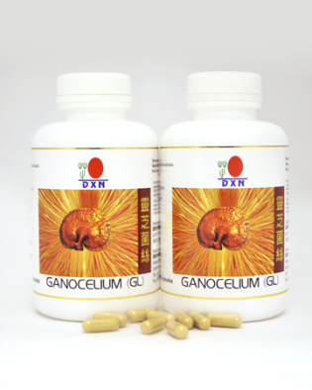
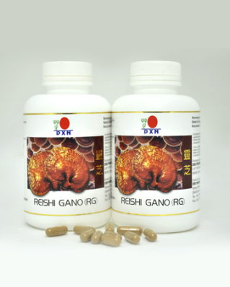
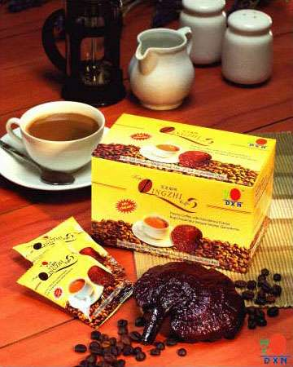
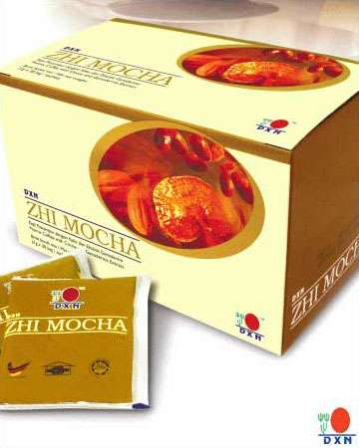
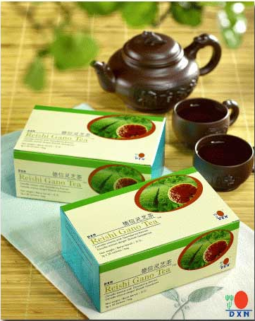
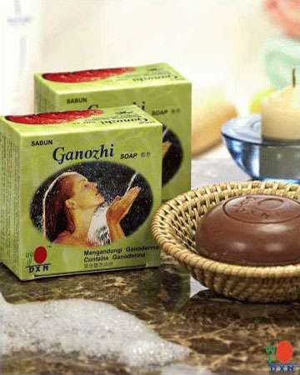
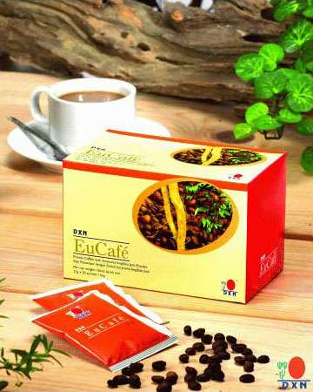
Icing On the Cake
Other Advantages:
No loss of SV point
Can buy any mix of products
The package is affordable to most people
Help to increase recruitment and bonus under the existing Marketing Plan
• Help to be promoted faster under the existing Marketing Plan
www.marktacorda.mydxn.net | www.dxn2u.com

Slide 13
Icing On the Cake
Participation:
• Member can buy any number of units to
create new lines. But only 2 generations can
be created. Using units bought in his/her own name.
•From the 3rd generation onwards, it should
be real new memebers in their Membership
code.
• If a member opts to buy more than 1 unit, all the units shall be purchased under the same hierarchy.
• The iupcode must be defined if the member wishes to park his/her own units or downlines under any specific line other than the 1st unit.
www.marktacorda.mydxn.net | www.dxn2u.com

Slide 14
Icing On the Cake
DXN LIFE-TIME INCOME
Potential Income for the € 200.00 iPackage
2 x 2 Structure = € 10,240.00
3 X 3 Structure = € 885,735.00
4 X 4 Structure = € 20,971,520.00
6 X 6 Structure = € 1,813,985,280.00
10 X 10 Structure = € 500,000,000,000.00
www.marktacorda.mydxn.net | www.dxn2u.com

Slide 15
DXN LIFE-TIME INCOME
1 TIME
INVESTMENT €200.00
Summary:
2 x 2 Structure = 10,240.00€
3 X 3 Structure = 885,735.00€
4 X 4 Structure = 20,971,520.00€
6 X 6 Structure = 1,813,985,280.00€
10 X 10 Structure = 500,000,000,000.00€
www.marktacorda.mydxn.net | www.dxn2u.com

Slide 16
Icing On the Cake
DXN LIFE-TIME INCOME
 |  | ICING ON THE CAKE - LETTER OF INTENT
 |  | Existing Member |  |  |  | New Member
Date: ___________________
Name: ____________________________________________ |  |  |  |  |  | Membership Code: ___________________
Number of iPackage units to be purchased: |  |  |  |  | Units
 | 1st unit of iPackage: |  | _______________________________
 |  |  | ( iUpcode )
 | 2nd unit of iPackage: |  | _______________________________
 |  |  | ( iUpcode )
 | 3rd unit of iPackage: |  | _______________________________
 |  |  | ( iUpcode )
 | Notes:
 | 1. For existing member, member only need to indicate iUpcode for 2nd unit of iPackage purchased
 | and onwards. 1st unit iUpcode will be auto assigned by the system.
 | 2. For new member, must indicate the iUpcode for all the units of iPackage purchased.
Payment Option:
 | Cash |  |  | Credit Card |  |  | Online Bank Transfer
Amount in words: |  | _______________________________________________ |  |  |  |  | EUR: _______________
Important: Payment shall be made directly to [ COMPANY NAME ] . Any DXN members or non-members are not
authorized to collect any payment of money representing DXN. For online bank transfer, please fax a copy of the
validated deposit slip at [ FAX NO. ].
I hereby agree to the Terms and Conditions of the |  |  |  |  | For Branch Use Only
Icing on the Cake (IOC) set by DXN.
 |  |  |  |  | Received by: .......................................................
 |  |  |  |  | Officer Name:
_________________________________________ |  |  |  |  | Position:
Signature Over Printed Name (DXN Member) |  |  |  |  | Date:
Date:
www.marktacorda.mydxn.net | www.dxn2u.com

Slide 17
DXN LIFE-TIME INCOME
www.marktacorda.mydxn.net | www.dxn2u.com

